Slide 1

Lecture 14
The Endocrine System

Slide 2
OVERVIEW
Transportation– how do we move things throughout our bodies?
Physiology of Hormones – what are hormones, how are they released, and what effects do they have on the body?
Control Center Glands – how do glands in the brain control the endocrine system?
Primary Glands – how do glands control the body?

Slide 3
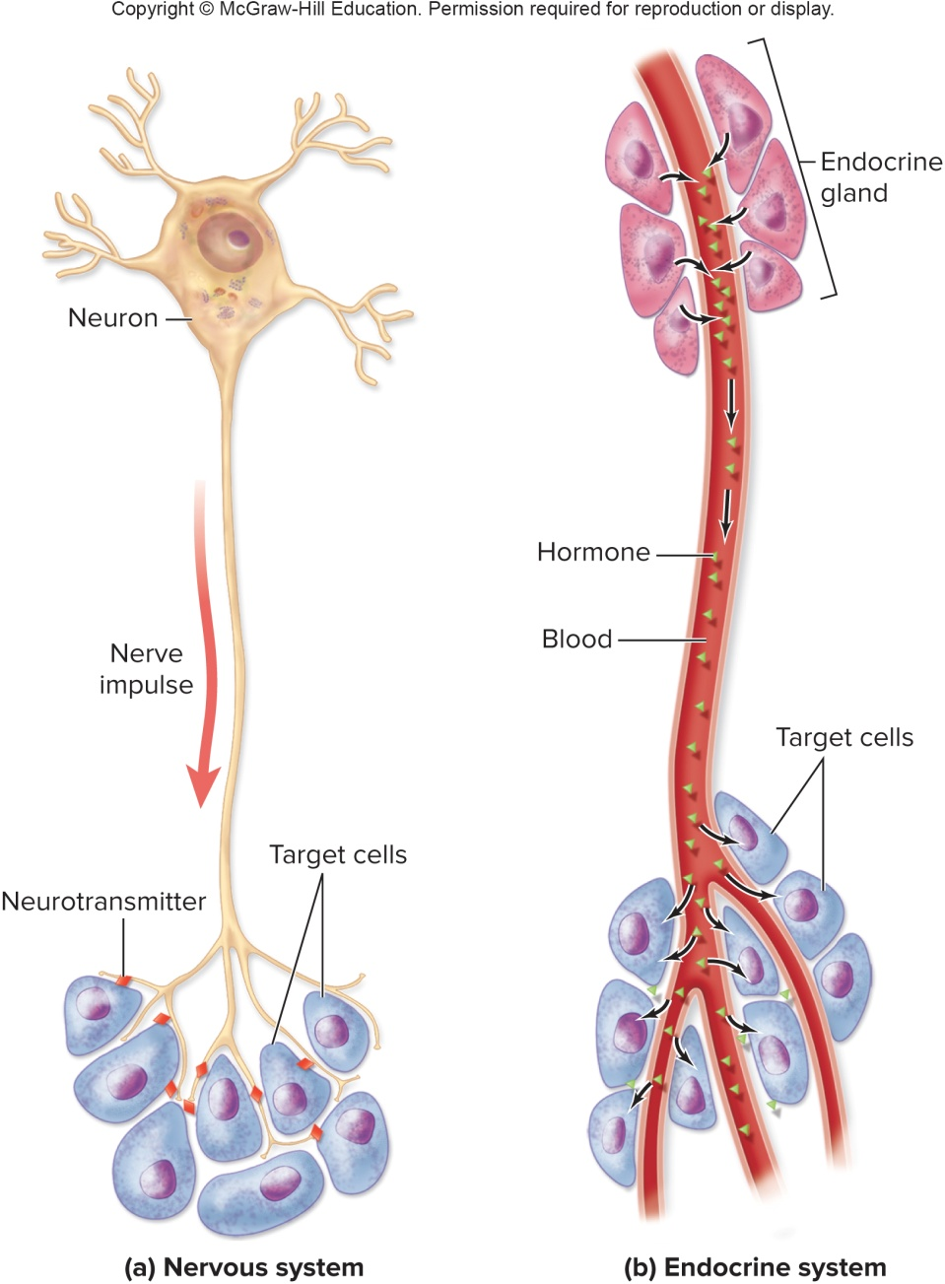
INTRODUCTION
The endocrine system is the slow-acting control system
  Nervous system: produces short-term, very specific responses
    Ex) Muscle contraction
  Endocrine system: produces more long-term, general responses
    Ex) Puberty
Hormones = Chemical messengers released into the blood by glands
Hormones control:
  Reproduction
  Growth and development
  Metabolism
  Homeostasis
Notes:
3

Slide 4
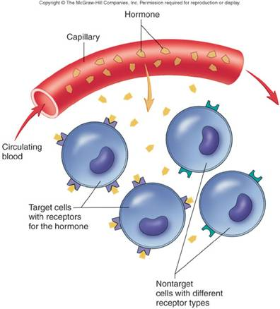
INTRODUCTION
Physiology of Hormones
  A hormone produced by a gland is secreted into the bloodstream
  The hormone travels to its target cell or organ
  The hormone binds to receptors on plasma membrane of the target
  The binding of a hormone then causes the cell to change
    What cellular changes occur depend on the hormone
Notes:
4

Slide 5
INTRODUCTION
Organs = Glands
Glands make hormones
Hormones have target cells
  Targets have receptor proteins that can be “unlocked” by hormones → change
Hormones travel all over the body via the bloodstream until they find their target
Notes:
5

Slide 6
EXOCRINE vs. ENDOCRINE
Exocrine glands: Secrete chemicals through a duct to a specific location
  Ex) Sweat glands, salivary glands, digestive pancreas
Endocrine glands: Secrete hormones into the bloodstream and access the whole body
  Ex) Thyroid gland, adrenal glands, endocrine pancreas

Slide 7
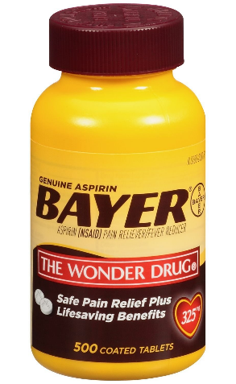
INTRODUCTION
3 Types of Hormones
  Steroid hormones
    Made from cholesterol (fat)
    Fat soluble (hydrophobic) – need to bind to proteins in plasma to travel in blood
  Amino acid derivatives
    Made from amino acids (proteins)
    Water soluble (hydrophilic) – can travel through blood without help
  Prostaglandins
    Derived from arachidonic acid, which is a fatty acid of cell membranes
    Cause pain and inflammation
    Blocked by NSAIDs
Notes:
7

Slide 8
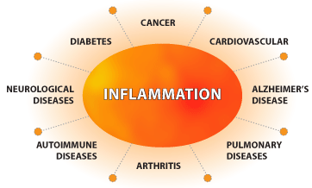
WHY DOES THIS MATTER
Prostaglandins cause inflammation
Initially: Inflammation helps the body counteract damage
Chronically: Inflammation can lead to a variety of health problems

Slide 9
INTRODUCTION
Hormone levels in the blood are maintained mostly by negative feedback
A change in the body triggers the release of more hormone in order to return to “normal”
  Ex) High blood sugar → Insulin release
Hormone release stops once an appropriate level in the blood is reached

Slide 10
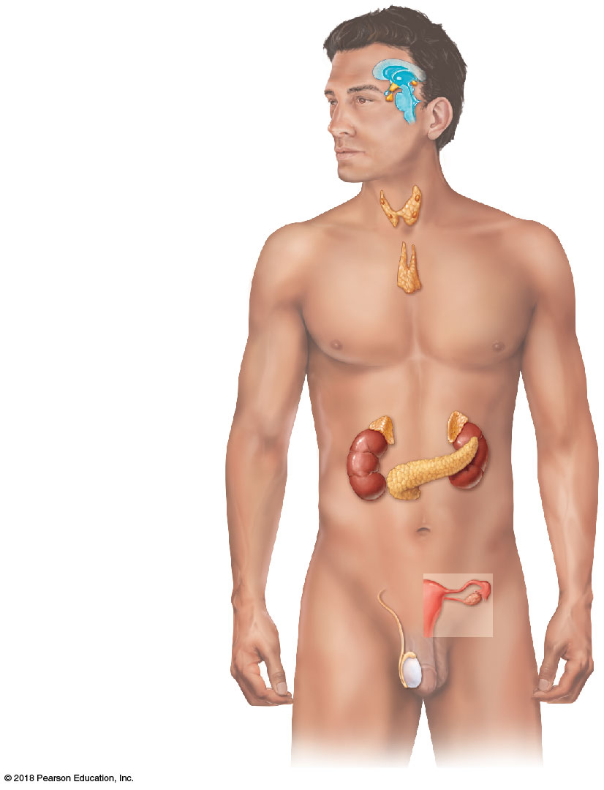
Pineal gland
The Major Endocrine Organs
Hypothalamus
Pituitary gland
Hypothalamus
Pituitary gland
Pineal gland
Thyroid gland
Parathyroid glands
Thymus
Adrenal glands
Pancreas
Gonads (testes and ovaries)
Thyroid gland
Parathyroid glands
Thymus
Adrenal glands
Pancreas
Ovary (female)
Testis (male)
Notes:
10

Slide 11
CONTROL CENTER GLANDS
3 Types of Glands
  Control Centers
    Control the action of primary glands
    Hypothalamus and Pituitary
  Primary
    Control the action of cells of the body
  Secondary
    Control the action of cells of the body in certain situations
    Endocrine role is not the primary function
Notes:
11

Slide 12
CONTROL CENTER GLANDS
Endocrine Control
Hypothalamus
ANS Control
Limbic System
Notes:
12

Slide 13
CONTROL CENTER GLANDS
The Hypothalamus
  2 Types of Hormones
    1) ”Releasing” Hormones
      Control the pituitary gland
      Ex) Thyroid Releasing Hormone from the hypothalamus causes the pituitary to release its hormone that affects the thyroid gland
    2) Primary Hormones
      Antidiuretic hormone (ADH)
      Oxytocin (OT)
      Stored in posterior pituitary
      Affect the body and do not regulate the pituitary
Notes:
13

Slide 14
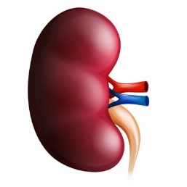
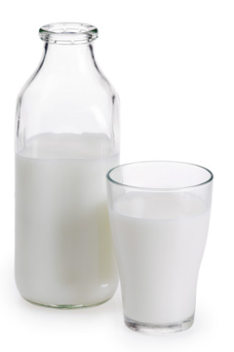
CONTROL CENTER GLANDS
The Hypothalamus: Primary Hormones
  Antidiuretic Hormone (ADH)
    TARGET = Kidneys
    FUNCTION = Causes the kidneys to retain water
  Oxytocin (OT)
    TARGET = smooth muscles of the uterus and mammary glands
    FUNCTION = Causes uterine contractions during labor and milk release when breast feeding
Notes:
14

Slide 15
Which medication you would give to a patient with water intoxication?
Antidiuretic
Diuretic
Notes:
15

Slide 16
Which medication you would give to a patient in shock (dangerously low blood pressure)?
Antidiuretic
Diuretic
Notes:
16

Slide 17
Which medication you would give to a patient with pulmonary edema (fluid in the lungs)?
Antidiuretic
Diuretic
Notes:
17

Slide 18
WHY DOES THIS MATTER?

Slide 19
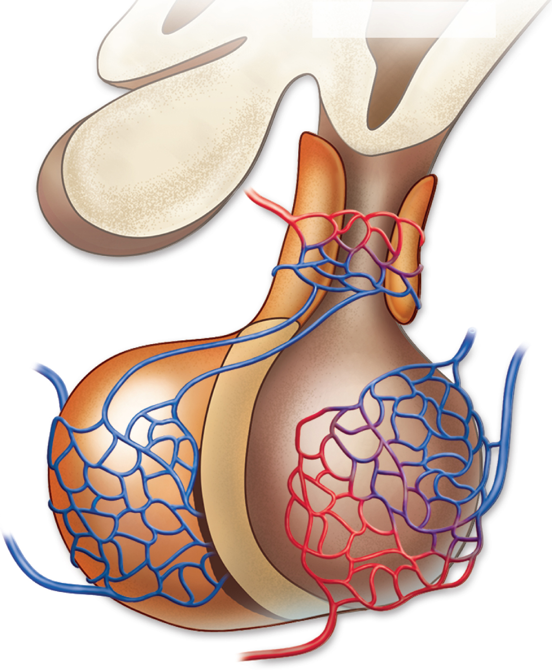
CONTROL CENTER GLANDS
The Pituitary Gland
  Connected to the hypothalamus via the infundibulum
    Numerous blood vessels allow for communication
  Protected by the sphenoid bone of the skull
    Within the sella turcica
  2 Lobes
    Anterior lobe produces hormones
    Posterior lobe stores hypothalamic hormones
HYPOTHALAMUS
Optic nerve
Infundibulum
Anterior lobe
Posterior lobe
Notes:
19

Slide 20
CONTROL CENTER GLANDS
The Pituitary Gland
  Anterior lobe = Epithelial (glandular) tissue
  Posterior lobe = Nervous tissue
  Links the hypothalamus with the rest of the endocrine system
Anterior
Posterior
Notes:
20

Slide 21
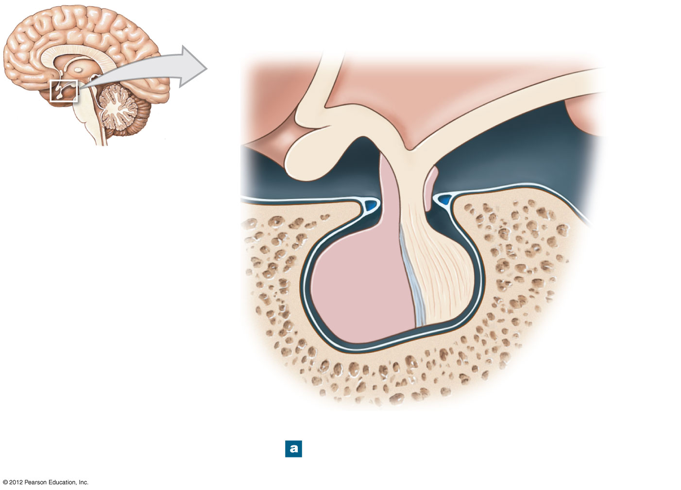
CONTROL CENTER GLANDS
The Pituitary Gland
  Controlled by hormones from the hypothalamus
  Releases 6 different hormones
    4 of these hormones control other glands in the body
HYPOTHALAMUS
PITUITARY
Sphenoid bone
Hypothalamus → Pituitary → Primary glands
Notes:
21

Slide 22
CONTROL CENTER GLANDS
6 Pituitary hormones
  2 Primary Hormones that affect the body and do not control other glands
    Growth hormone (GH) – affects cell division and growth
    Prolactin (PL) – affects mammary tissue
  4 “Stimulating Hormones” that control other glands
    Follicle-stimulating hormone (FSH) – affects gonads
    Luteinizing hormone (LH) – affects gonads
    Thyroid stimulating hormone (TSH) – affects thyroid
    Adrenocorticotropic hormone (ACTH) – affects adrenal glands
  “Stimulating Hormones” stimulate other glands to secrete their own hormones

Slide 23
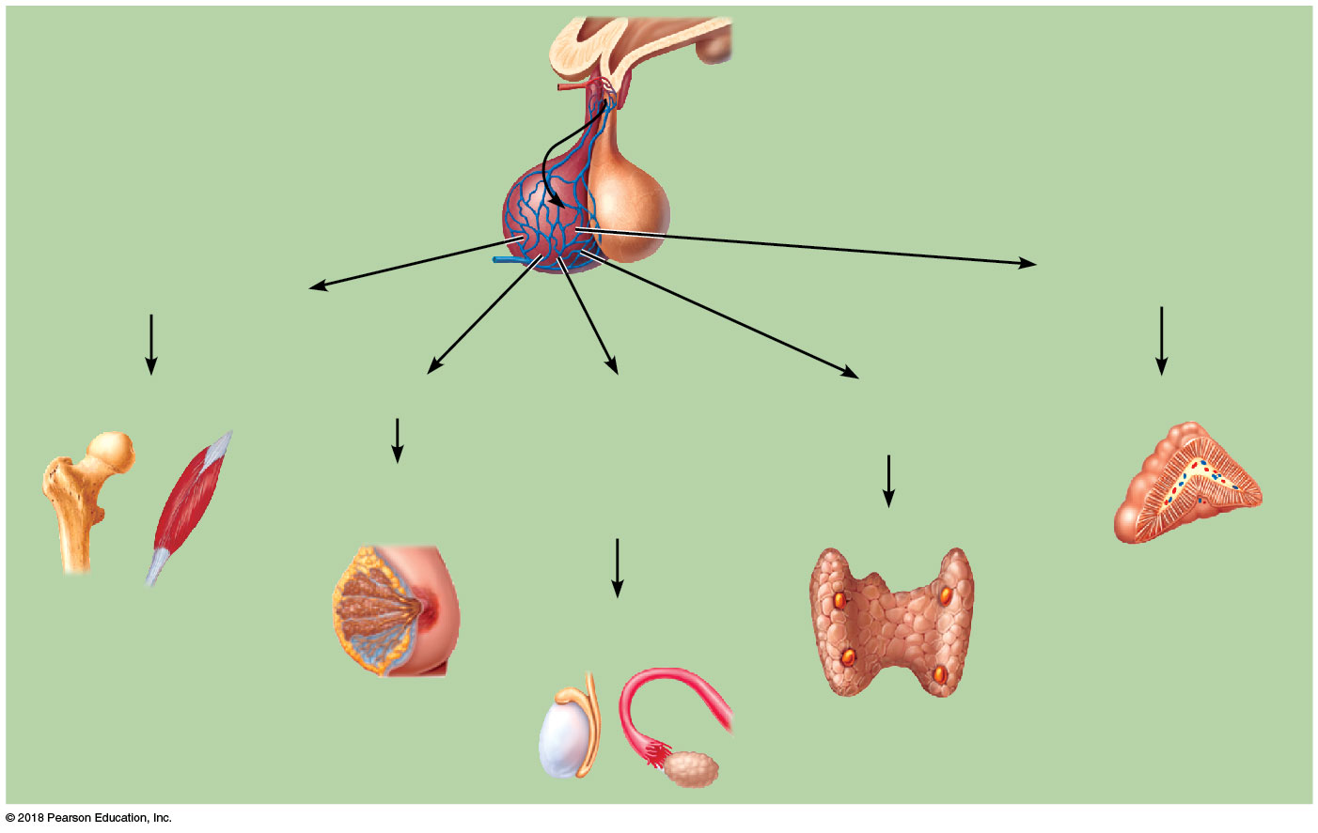
CONTROL CENTER GLANDS
Pituitary
Adrenocorticotropic
hormone (ACTH)
Growth hormone (GH)
Bones and muscles
Prolactin (PRL)
Follicle-stimulating hormone (FSH)
and luteinizing
hormone (LH)
Thyroid Stimulating
hormone (TSH)
Adrenal cortex
Mammary glands
Thyroid
Testes or ovaries

Slide 24
Hypothalamus
Releasing hormones
Pituitary
Stimulating hormones
Primary glands

Slide 25
Hypothalamus
TRH
Thyroid Releasing Hormone
Pituitary
TSH
Thyroid Stimulating Hormone
Thyroid gland
T4
Thyroid Hormone
ALL Cells increase metabolism

Slide 26
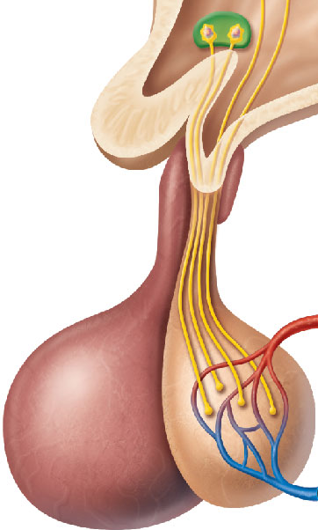
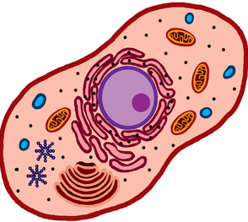
TRH
TSH
T4

Slide 27
Identify the Hypothalamus:

Slide 28
Click on the Anterior Lobe of the Pituitary:

Slide 29
Click on the Posterior Lobe of the Pituitary:

Slide 30
Where is Oxytocin is produced?

Slide 31
Where Antidiuretic Hormone (ADH) is stored?

Slide 32
Where is Thyroid Stimulating Hormone (TSH) produced?

Slide 33
Identify the infundibulum:

Slide 34
CONTROL CENTER GLANDS
What skull structure protects the pituitary gland?
  a. The cribriform plate of the ethmoid bone
  b. The sella turcica of the ethmoid bone
  c. The cribriform plate of the sphenoid bone
  d. The sella turcica of the sphenoid bone
Notes:
What skull structure protects the pituitary gland?
Wait for answers (answer = D)

Slide 35
CONTROL CENTER GLANDS
Negative feedback
  Too much thyroid hormone from the thyroid gland will decrease the release of pituitary TSH
  Too little thyroid hormone from the thyroid gland will increase the release of pituitary TSH
The pituitary responds to the hormones of the glands it “stimulates”

Slide 36
TSH
TSH
TSH
TSH
TSH
TSH
TSH
TSH
TSH
TSH
TSH
TSH
TSH
TSH
TSH
TSH
T4
T4
T4
T4
T4

Slide 37
TSH
T4
T4
T4
T4
T4
T4
T4

Slide 38
CASE STUDY
Cole Dasice
  Complaint: Sudden weight gain without a change in diet, always cold
Diagnosis = HYPOTHYROIDISM
  Too little thyroid hormone
  Autoimmune destruction of the thyroid gland
Lab Work
  T4 (Thyroid Hormone) = 2.0 ug/dl– Low
  TSH (Thyroid Stimulating Hormone) = 7.1 ug/dl
    Is “7” high or low for TSH?

Slide 39
HYPOTHYROIDISM
TSH
TSH
TSH
TSH
TSH
TSH
TSH
TSH
TSH
TSH
TSH
TSH
TSH
TSH
TSH
TSH
TSH

Slide 40
CONTROL CENTER GLANDS
“7” is high! TSH will be HIGH when there is too little Thyroid Hormone!
TSH goes up when there is not enough Thyroid Hormone to try to “stimulate” it as much as possible
Think About It: What happens to TSH in HYPERTHYROIDISM (or a disease where too much thyroid hormone is produced)?

Slide 41
PRIMARY GLANDS
Primary Glands control the activity of organs
    Thyroid gland
    Parathyroid glands
    Adrenal glands
    Pancreas
    Reproductive glands
    Pineal gland
Each gland’s hormones affect the body in different ways
Notes:
41

Slide 42
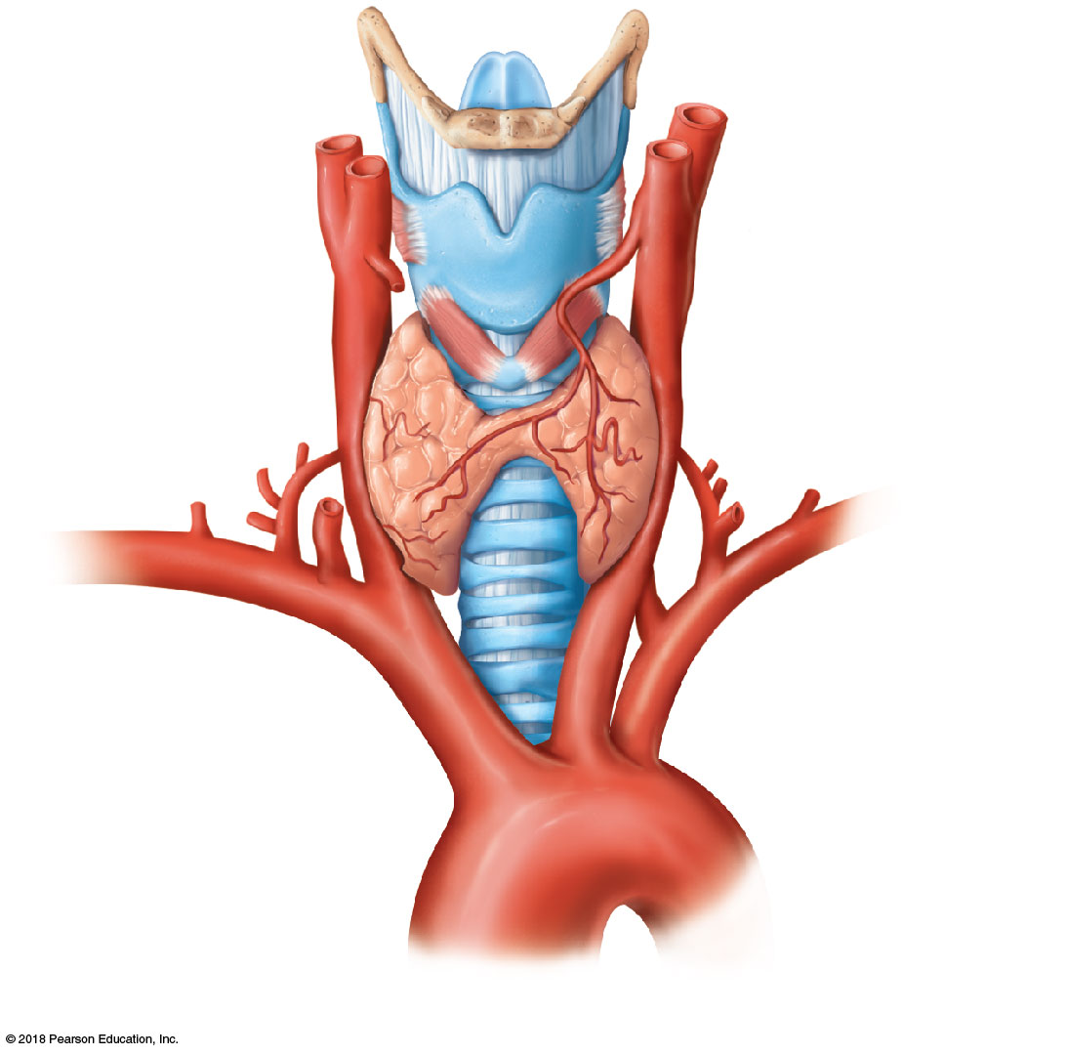
PRIMARY GLANDS
The Thyroid Gland
  Thyroid Hormone (T4) = metabolism
    Controls rate of ATP formation
    Needed for tissue growth and development
  Made of two lobes over the anterior trachea
  Consists of thyroid follicles
      Follicles make thyroid hormone
      Iodine is required to make thyroid hormones
Isthmus of
thyroid gland
Trachea
Left lobe of
thyroid gland
Aorta
Notes:
42

Slide 43
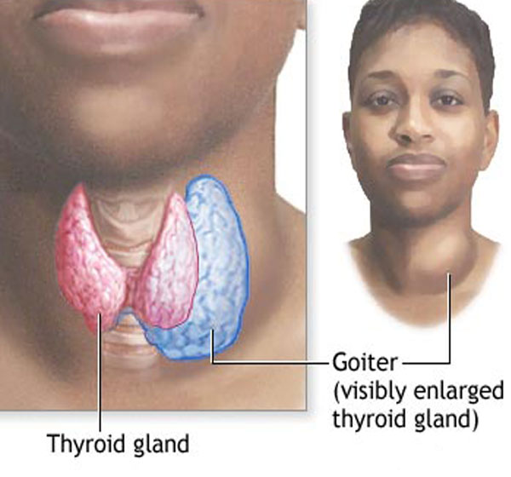
PRIMARY GLANDS

Slide 44
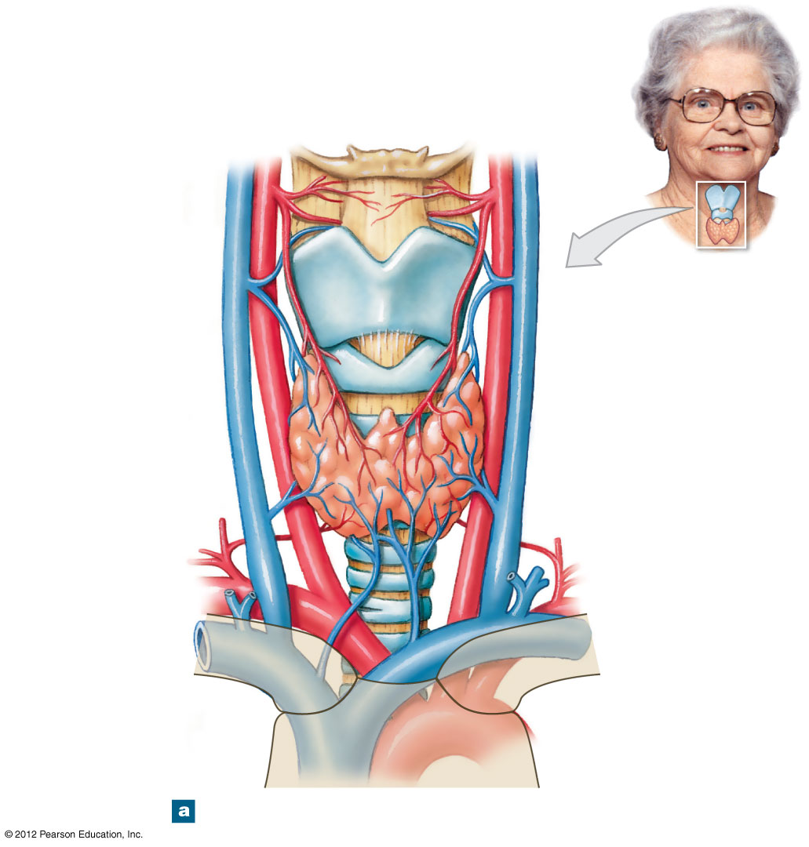
PRIMARY GLANDS
All endocrine glands are vascular
Internal
jugular vein
Common
carotid artery
Left lobe of
thyroid gland
Right lobe of
thyroid gland
Isthmus of
thyroid gland
Notes:
44

Slide 45
PRIMARY GLANDS
Hormones of the Thyroid Gland
  Thyroid Hormone, aka Thyroxine (T₄)
    Targets ALL cells of the body
    Causes a general increase in body metabolism
  Calcitonin
    Targets osteoclasts, and reduces their actvitiy
    Decreases blood calcium levels
Notes:
45

Slide 46
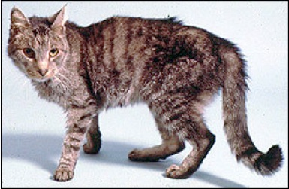
PRIMARY GLANDS

Slide 47
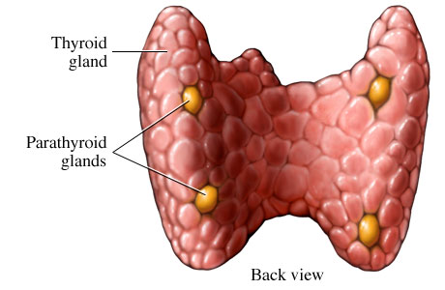
PRIMARY GLANDS
The Parathyroid Glands
  Located on the posterior portion of the thyroid gland
Notes:
47

Slide 48
PRIMARY GLANDS
Hormones of the Parathyroid Glands
  Parathyroid Hormone (PTH)
    Targets osteoclasts and kidneys
    Causes osteoclasts to remove calcium ions from bone
    Osteoclasts will put calcium ions into the blood thus increasing blood calcium ion levels
Notes:
48

Slide 49
PRIMARY GLANDS
What hormone performs the exact opposite function of parathyroid hormone?
  a. Calcitriol from the skin
  b. Cholecalciferol from the gut
  c. Calcium from the kidneys
  d. Calcitonin from the thyroid gland

Slide 50
PRIMARY GLANDS
The Thymus
  Located in the upper thorax, posterior to the sternum and superior to the heart
  Largest in infants and children
    Decreases in size throughout adulthood
  Makes T-Cells
    Via a hormone called thymosin
    Important in developing the immune system

Slide 51
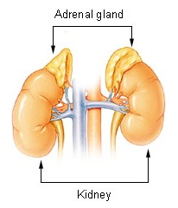
PRIMARY GLANDS
The Adrenal Glands
  Located superior to the kidneys
  Hormones participate in stress response and water balance
Notes:
51

Slide 52
PRIMARY GLANDS
The Adrenal Glands
  2 Layers of the Adrenal Gland
    Adrenal cortex
    Adrenal medulla
  3 Layers of the Adrenal Cortex
    Outer layer
    Middle layer
    Inner layers
Notes:
52

Slide 53
PRIMARY GLANDS
Anatomy of the Adrenal Glands
  Adrenal medulla
    Produces epinephrine
    Epinephrine → increased oxygen delivery
      Constricts blood vessels
      Increases heart rate
      Increases respiration
Notes:
53

Slide 54
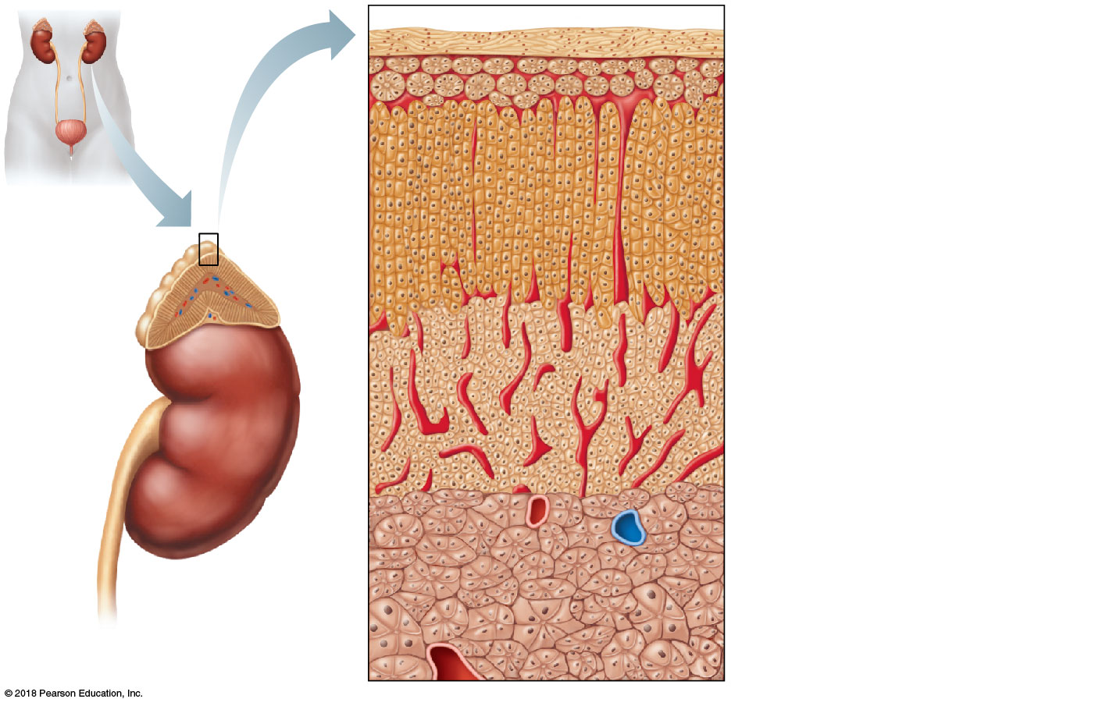
PRIMARY GLANDS
Anatomy of the Adrenal Glands
  Adrenal Cortex
    Outer layer produces mineralocorticoids
    Middle layer produces glucocorticoids
    Inner layer produces androgens
Adrenal gland
Capsule
Kidney
Mineralocorticoid- secreting area
Glucocorticoid- secreting area
Adrenal gland
Cortex
Adrenal cortex
Medulla
Cortex
Kidney
Sex hormone- secreting area
Medulla
Adrenal
medulla
Notes:
54

Slide 55
PRIMARY GLANDS
Hormones of the Adrenal Cortex
  Mineralocorticoids
    Produced in outer layer of the adrenal cortex
    Regulate water and electrolyte balance
      Like the mineral (or salt) content of blood
    Target organ is the kidney

Slide 56
PRIMARY GLANDS
Why do physicians typically recommend patients with high blood pressure eat low-salt diets?
  a. Salt, like mineralocorticoids, will increase blood volume
  b. Salt, like mineralocorticoids, will decrease blood volume
  c. Salt, like mineralocorticoids, will not change blood volume

Slide 57
PRIMARY GLANDS
DISCLAIMER: Salt from your diet that enters your blood will decrease mineralocorticoid release through the process of negative feedback.
As a result, many suggest that if you have healthy adrenal glands and kidneys, low salt diets don’t matter!

Slide 58
PRIMARY GLANDS
Hormones of the Adrenal Cortex
  Glucocorticoids
    Produced by middle layer of adrenal cortex
    Increases blood sugar → more sugar available for “fight or flight”
    Suppresses the immune system → more sugar available for “fight or flight”
      Anti-inflammatory
      Prednisone mimics glucocorticoids
    Released in response to increased blood levels of ACTH

Slide 59
PRIMARY GLANDS
Hormones of the Adrenal Cortex
  Androgens (Sex Hormones)
    Produced in the inner layer of the adrenal cortex
    Small amounts are made throughout life
    Most of the hormones produced are androgens (male sex hormones), but some estrogens (female sex hormones) are also formed

Slide 60
Identify the Thyroid Gland:
Notes:
60

Slide 61
Identify the Parathyroid Glands:
Notes:
61

Slide 62
Identify the Thymus:
Notes:
62

Slide 63
Identify the Adrenal Glands:
Notes:
63

Slide 64
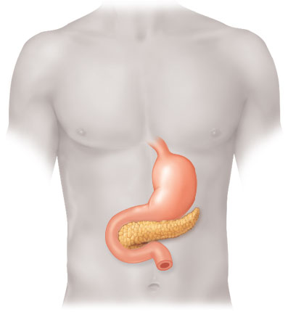
PRIMARY GLANDS
The Pancreas
  The pancreas is an endocrine and exocrine gland
  Endocrine function
    Consists of pancreatic islets
    Produces hormones
    Maintains blood sugar homeostasis
  Exocrine function
    Consists of pancreatic lobules
    Produces digestive enzymes
Notes:
64

Slide 65
PRIMARY GLANDS
Hormones of the Pancreas
  Glucagon
    Produced by alpha cells of the islets
    Released when blood sugar levels are low
    Raises blood sugar levels by stimulating the liver to put glucose into the bloodstream
  Insulin
    Produced by beta cells of the islets
    Released when blood sugar levels are high
    Lowers blood sugar levels by transporting sugar into cells
Notes:
65

Slide 66
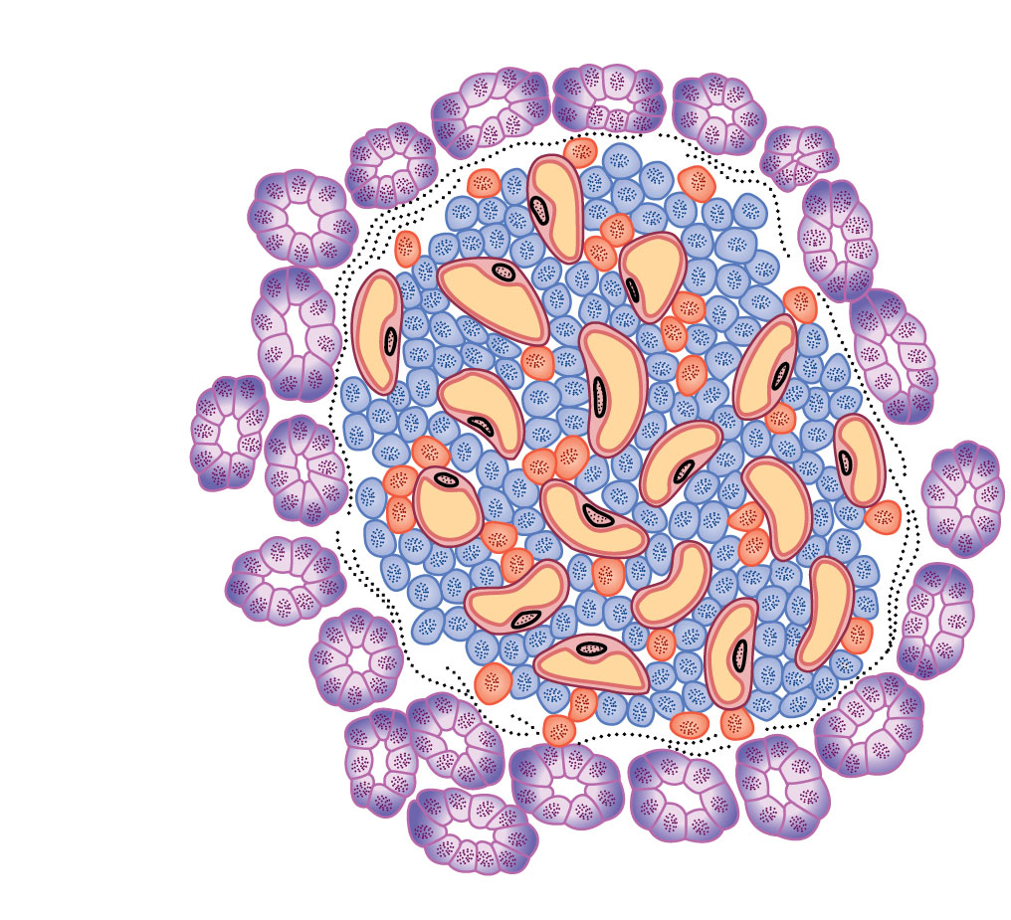
PRIMARY GLANDS
Exocrine cells of pancreas
Alpha (α) cells secreting glucagon
Beta (β) cells secreting insulin

Slide 67
WHY DOES THIS MATTER?
Diabetes
  = Sugar can’t get into cells, so it stays in blood
  Type I = Autoimmune destruction of Beta cells that produce insulin
  Type II = Insulin resistance

Slide 68

This video is also posted on Bb
Notes:
This video is also posted on BlackBoard under the Unit 4 Lessons tab.

Slide 69
PRIMARY GLANDS
Hormones of the Gonads
  Testosterone (males) and Estrogen/Progesterone (females)
    TARGET = Testes, ovaries
    FUNCTION = Promotes the production of sperm and eggs
      Influences secondary sex characteristics
Notes:
69

Slide 70
PRIMARY GLANDS
The Pineal Gland
  Part of the epithalamus
  Synthesize the hormone melatonin:
    Controls sleep cycles
    Production rises at night and declines during the day
    Can affect reproductive organs
Notes:
70

Slide 71
Identify the Pancreas:
Notes:
71

Slide 72
Identify the Gonads (male or female):
Notes:
72

Slide 73
Identify the Pineal Gland:
Notes:
73

Slide 74
SECONDARY GLANDS
Secondary glands: Organs that can act like glands, but whose primary function of is NOT endocrine
Examples:
  Kidneys
    Erythropoietin increases RBC production
    Renin raises blood pressure
  Heart
    Atrial natriuretic peptide (ANP) lowers blood pressure
  Digestive organs
    Various hormones stimulate digestion and digestive reflexes
Notes:
74

Slide 75
SUMMARY
Summary
  There are 2 types of glands: Control Centers, Primary Glands
    The hypothalamus, a control center gland, controls the release of pituitary hormones
    The pituitary gland, a control center gland, releases hormones which control the action of certain primary glands
    Primary glands all have very unique functions, and include: Thyroid, Adrenal, Pancreas, Reproductive, and Pineal glands
Notes:
75

